Slide 1
Capstone Project :
Predicting the Outcome of H-1B Visa Applications
Introduced by Group 2 :
Aarti Gupta
Shreekrishna Jadhav
Mahendra Jogvankar
Shardul Jadhav
Saad Khan
Sumit Gaikwad

Slide 2
Introduction
(
Dataset Name : “H-1B_Disclosure_Data_FY17”
This dataset contains information about the applicants who are applying for H1B visas.
Shape : [5,28,146, 40 ] i.e.[Row, Columns]
Datatypes : Dataset contains 37 object variables and 3 (int and float) variables .
Target variable : CASE_STATUS (Certified, Certified Withdrawn, Withdrawn, Denied)
Our target variable is highly imbalanced, which can be analysed further using appropriate techniques.
Classification problem.
A few features have high percentage of null values in dataset. Also, there are a few features which are highly imbalanced.

Slide 3
Problem Statement
This H-1B visa dataset is from the financial year 2017. The aim of this project is to predict whether the applicant is eligible for H-1B visa based on the applicant information or not .
According to the problem statement, we consider only H-1B applicants from the dataset.
H-1B is a type of non-immigrant visa in the United States that allows foreign nationals to work in occupations that require specialized knowledge and a bachelor’s degree or higher in the specific specialty.
According to the business problem specified, we have a steady interest only in the cases that are ‘Certified’ & ‘Denied’ from the Employer’s point of view & to build a model that we believe could be a useful resource both for the future H-1B visa applicants and the employers who are considering to sponsor them.

Slide 4
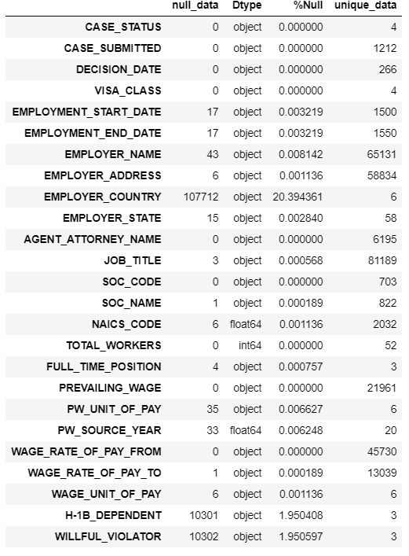
Feature Understanding
There are only 3 numerical variable in our dataset ,rest of them are all categorical in nature.
Employer_Country has got maximum null values amongst all variables.
Wage Rate of pay to has got only one null value.

Slide 5
Process Flow
EDA on our dataset: Missing values & Null values treatment, Univariate & Bivariate analysis .
Base Model : Decision Tree.
Feature Engineering on dataset.
Hypothesis Testing and Statistical test: Chi-square test, ttest
Final Model building.
Limitation and Challenges
Conclusion and future scope

Slide 6
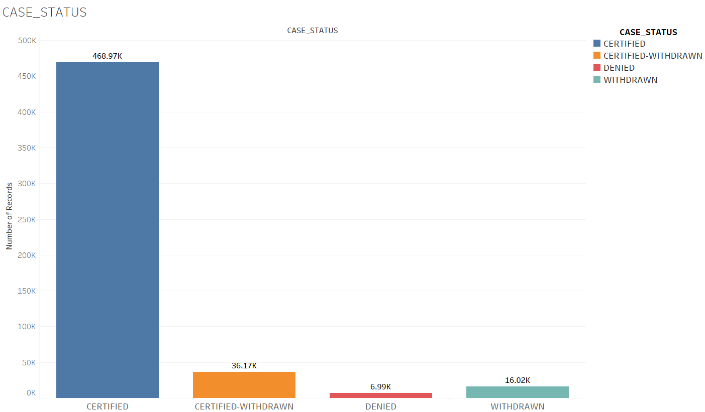
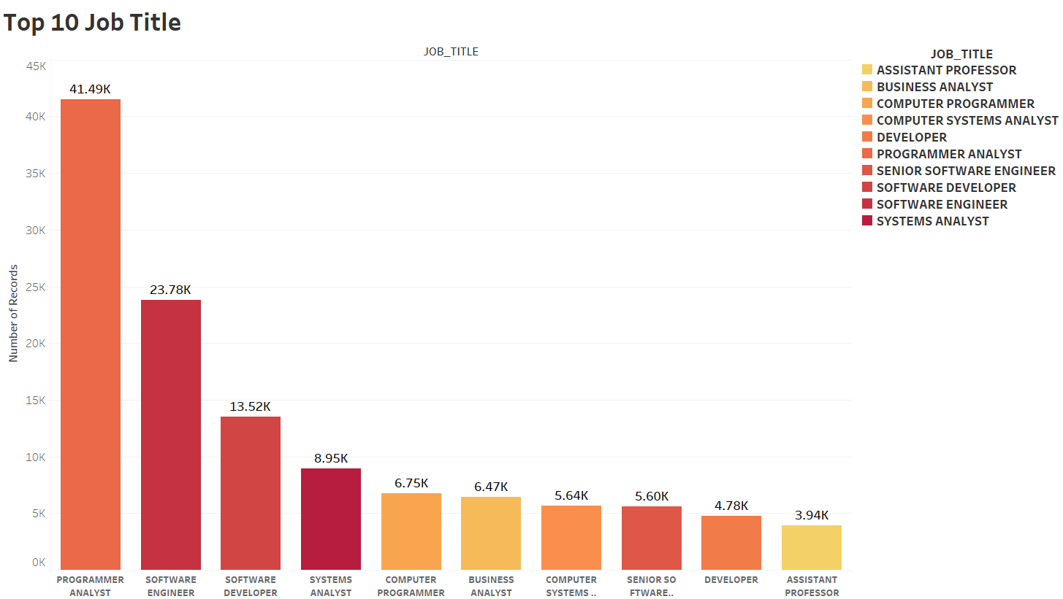
EDA Univariate Analysis
CASE STATUS
JOB TITLE
Around 88 % of total applicants have a Certified H-1B visa, whereas only 1 % of the applicants got their visa denied.
Programmer Analyst and Software Engineer
are job titles with highest demand amongst all.

Slide 7
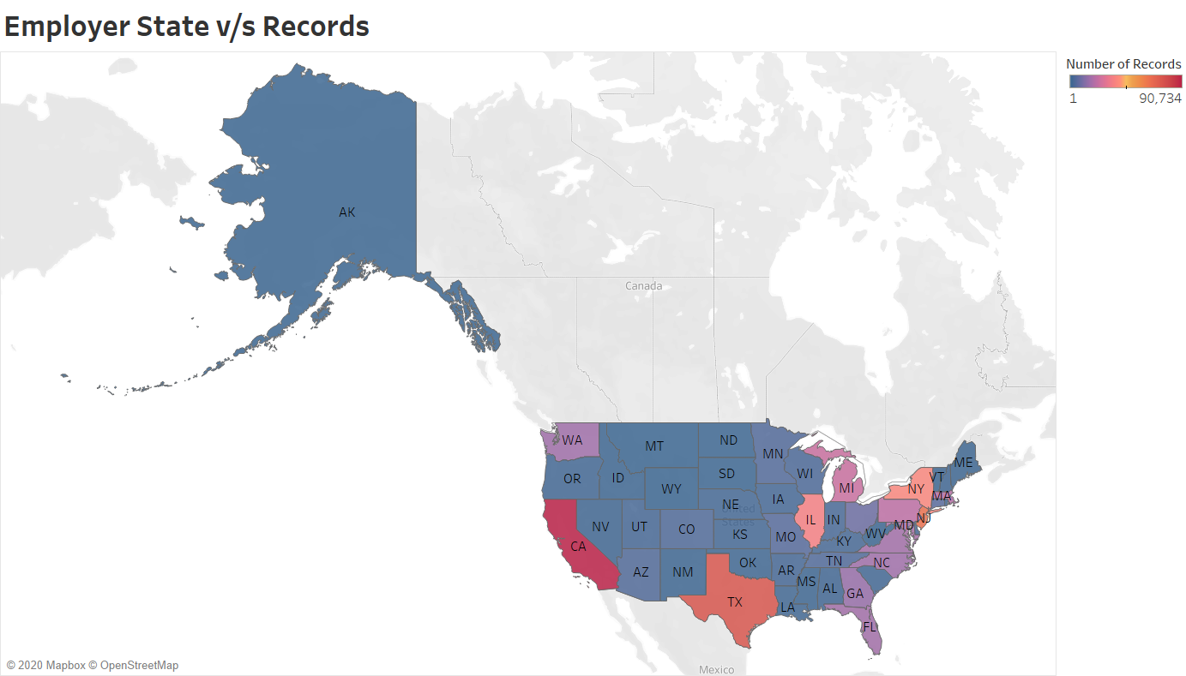
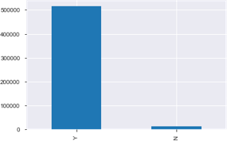
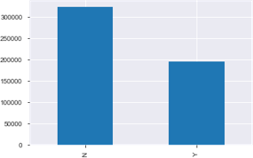
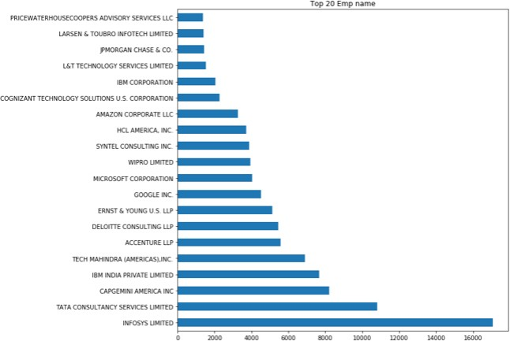
Most of the applicant are from state like CA ,TX, Nj
There are lot of employer offering full time position job
H-1B Dependent:61% of the applicant and 39% are non H-1B dependent
The highest applicants are for Employer Infosys, Capgemini, IBM, Tech Mahindra

Slide 8
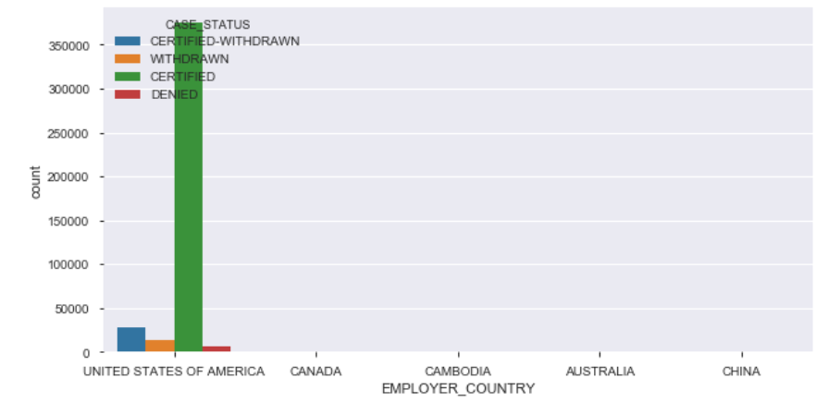
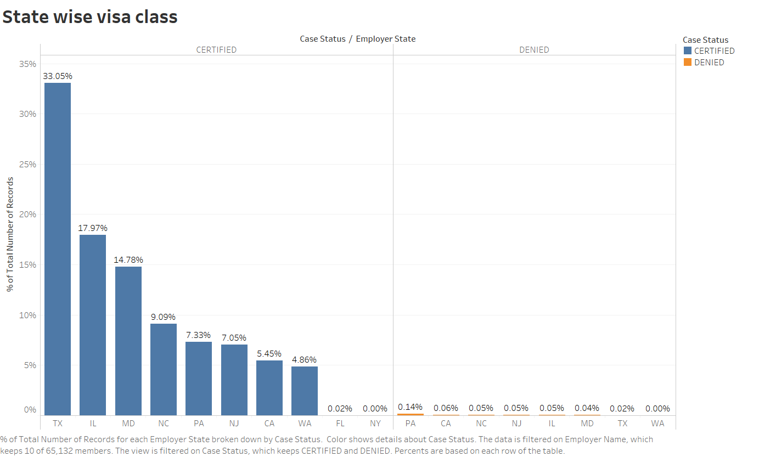
Bivariate Analysis
Employer Country v/s Case Status
Employer State v/s Case Status
Employers Country USA has maximum number of Applicants
The applicants are maximum for California, Texas and New Jersey

Slide 9
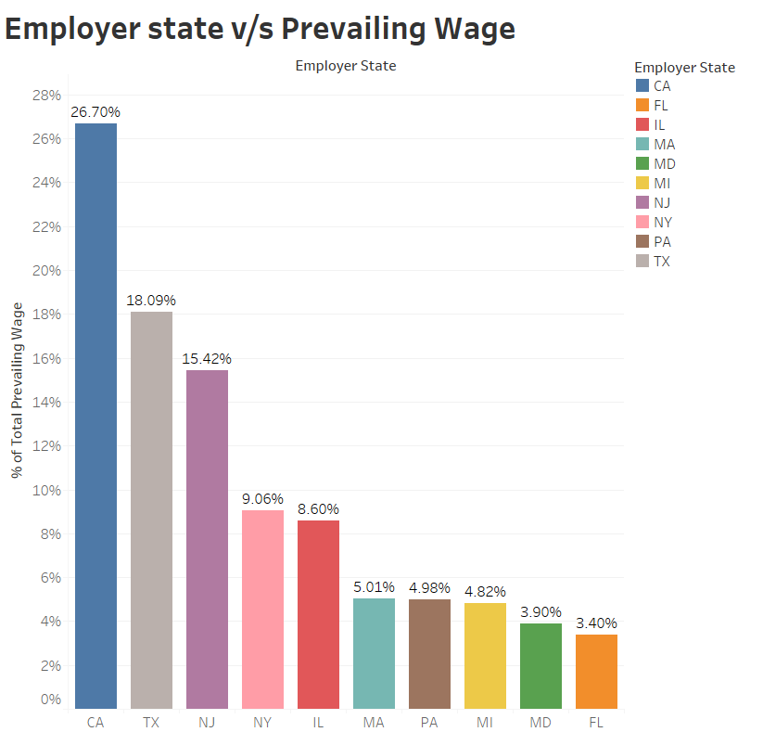
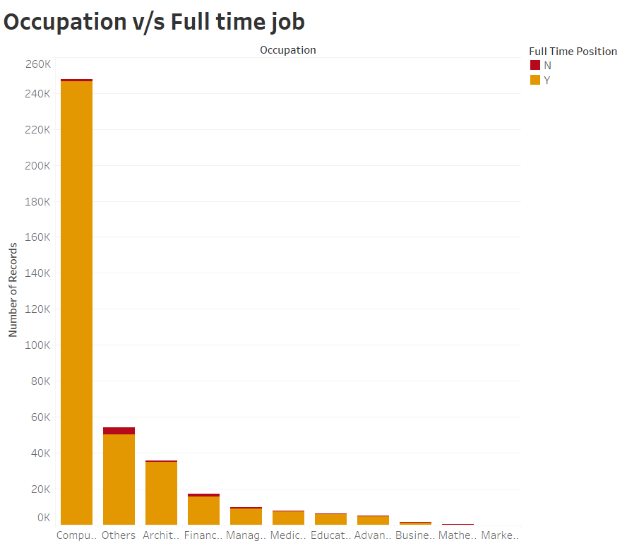
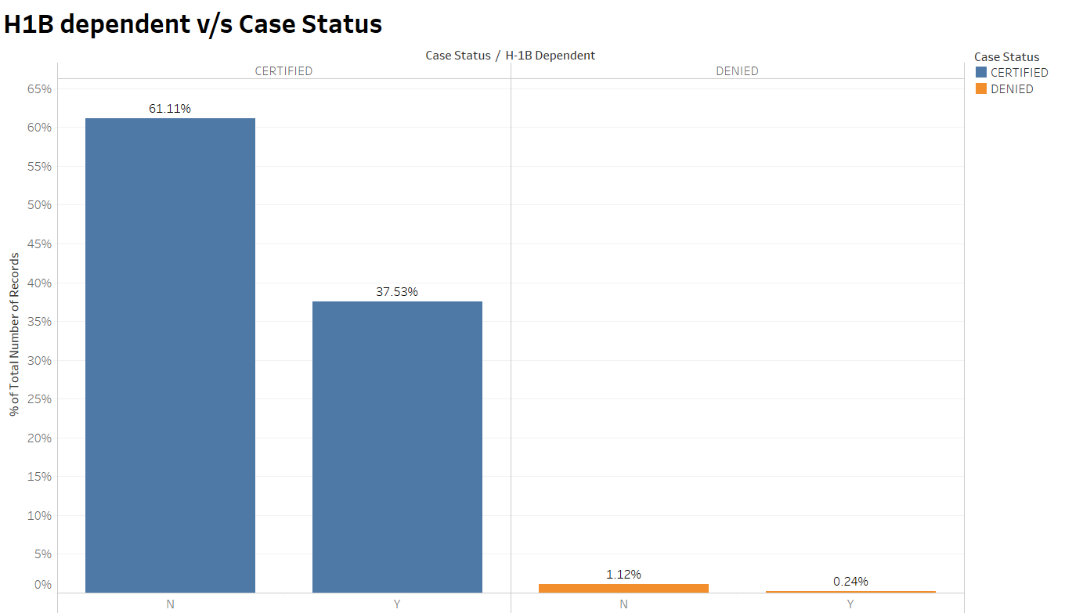
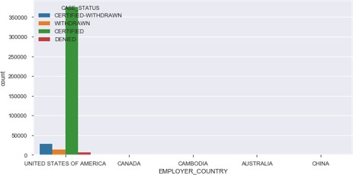
The applicants from CA have the highest PW wage followed by TX,NJ
IT and Computer domain has got highest number of full time job titles as compared to the rest of the occupations
The applicants H-1B visa status (Certified/Denied) is independent of the H-1B dependent status of the applicants.
Maximum number of applicants hail from country USA

Slide 10
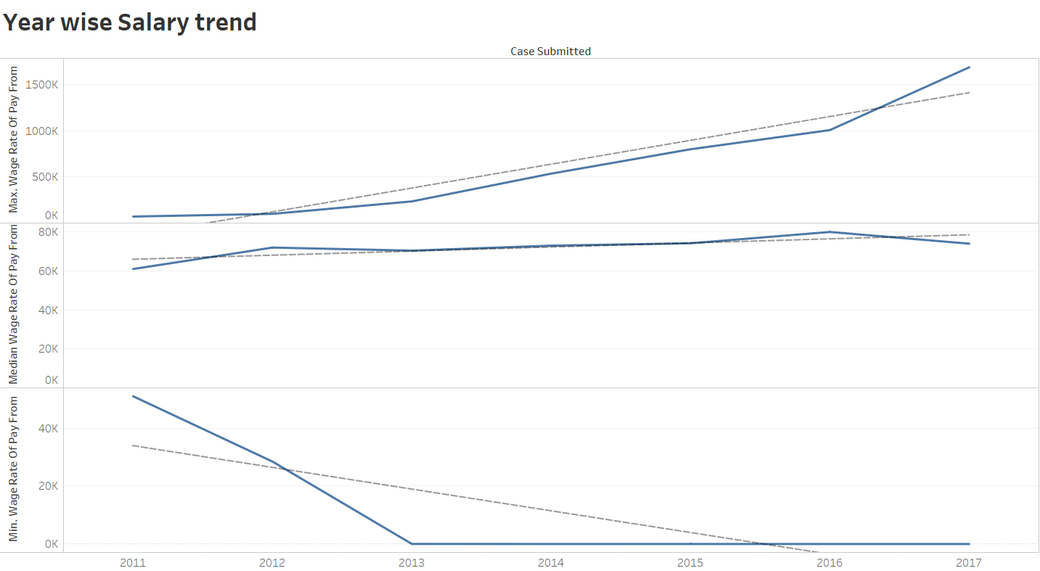
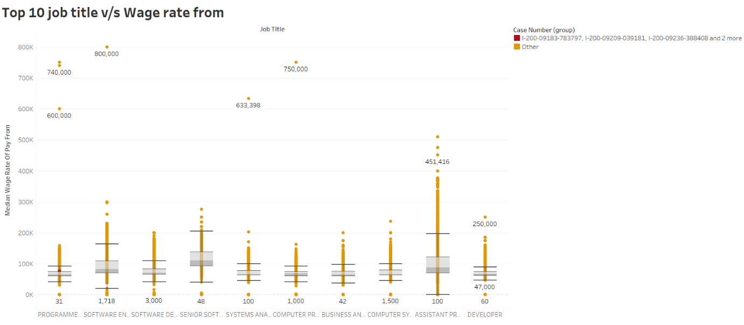
Year Wise Salary Trend
Top 10 Job title vs Wage rate From

Slide 11
TREATING NULL VALUES and ANAMOLIES In DATASET
EMPLOYER_NAME : Null values are treated by doing appropriate imputations by finding a particular pattern based on the address of the EMPLOYER.
FULL_TIME_POSITION : Two types of values i.e. Yes or No, whether employer offers a Full_Time_Job or not. The null values here are imputed based on proper finding of mode i.e. ‘No’.
PREVAILING_WAGE : We have a lot of employers offering 0 prevailing wage, which is not possible. Hence, a pattern is been studied for the employer name & prevailing wage & this problem is solved.
PW_UNIT_OF_PAY : Null values have been treated based on the theory of ‘Mode’ imputation.
H-1B_DEPENDENT : This is a categorical column with two categories , Yes or No. So we can treat null values by Mode imputation. Here, we replace null values by ‘No’, which is the mode of the feature.
WILLFUL_VIOLATOR : Again this is a categorical feature which has got two categories i.e. Yes or No. So we can treat null values by imputing ‘No’, which is the mode of the feature.

Slide 12
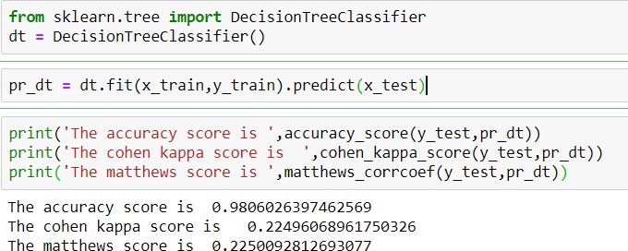
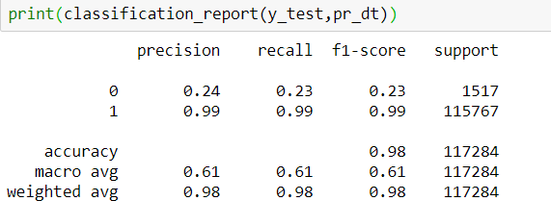
Base Model
After basic EDA & data pre-processing, we split the data into Train set & Validation set.
We choose Decision Tree as the base model & fit our model on the training data to predict test data
The accuracy score:98%, which is quite evident that the data is raw. There is no Data Analysis done.
For ‘Certified’, we have a precision score of 24 % and recall score of 99 %.
For ‘Denied’, we have a precision score of 99 % & recall score of 99 %.

Slide 13
Feature Engineering
By using domain knowledge of the dataset, we’ve done Feature Engineering to create features that make machine learning algorithms work. This is a fundamental to the application of machine learning, which will not just improve the accuracy of our model but will also help us to boost the predictive power of the model.
Emp_Stay_Duration_Yr : This is employers working duration in the foreign country i.e. the total no. of years employee stays there for his job.
CS_DD_Duration : It basically explains the total processing time required for visa application. This is extracted using features case submission and decision date.
Employer Frequency : Total no. of times an employer files for an application.
PWGrWGFm : This feature is created based on features such as Prevailing wage and Wage proposed by employer, ‘Yes’ : Prevailing Wage, ‘No’ : No Prevailing Wage
PW_UNIT_OF_PAY : Here, mostly all of the employers pay on an yearly basis, so converting ‘Week’, ‘Month’, ‘Bi-Weekly’ to an yearly basis, so we get only ‘Year’ & ‘Hour’ basis payment for the prevailing wage.
CASE_STATUS: We have mapped case_status with values 0 & 1 (Certified : 1 and Denied : 0).

Slide 14
Statistical Test Analysis
Observing the statistical test of all the features, we could conclude which variable is very much significant to our dataset & will clearly help to boost the accuracy of our model.
Similarly, we have performed statistical tests with all our features to know their significance. Here’s what we ended up with:
Significant features : Full time position, Prevailing Wage, PW unit of pay, H-1B Dependent, Willful Violator, Employer Stay Duration Year, Occupation, PWGrWgFm, Agent Attorney, Employer Frequency
Insignificant Features : Total_Workers, PW_Source_Year

Slide 15
Final Model
We built our final model based on:
Hyperparameter Tuning: Using GridSearchCV
Model performed better after hyperparameter tuning and the predictive power of our model substantially increased as compared to the model built before hyperparameter tuning.
This gave us average F1 Score, Recall, Precision Score overall when compared with model with imbalanced.
The validation score that we obtained was a clear indication that overfitting problem of our model has been mitigated purely.
Out of the models we tried, Random Forest had the best accuracy with the best parameters obtained using GridSearchCV outperformed all the other models with 86% training accuracy and 91% test accuracy on the under sampled balanced test data.

Slide 16

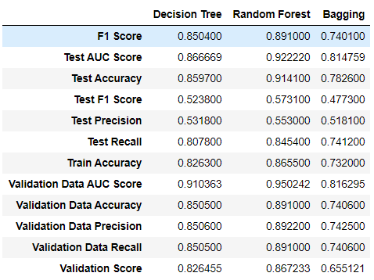
Final Model
After Hyperparameter Tuning:
Best Model: Random Forest
F1 Score : 89 %
Train Accuracy: 86 %
Test Accuracy : 91 %
Precision Score : 89 %
Recall Score : 84 %
Validation Score: 86 %

Slide 17
Limitation and Challenges
Our dataset is highly imbalance and the reason for the model to not perform well enough.
Lead to get poor accuracy, validation score, Precision, F1 score in the models that we built to know the accuracy.
The original dataset before any EDA, Feature Transformation or SMOTE is highly biased towards predicting only a particular value, for eg: in the case status predicting More 1’s (Certified) as compared to 0’s (Denied).
Also the data was provided was from a single financial year 2017.Getting more data from previous financial years would have provided us with rich quality of data to be dealt with.
There are a lot of features created due to dummification.
Extensive H-1B visa domain knowledge is required for selecting the features and limiting the dummified values.

Slide 18
Conclusions & Future Work
Out of the models we tried, Random Forest had the best accuracy with the best parameters obtained using GridSearchCV outperformed all the other models with 86% training accuracy and 91% test accuracy on the under sampled balanced test data. This model was obtained after undersampling technique.
Overall, this model performed better after hyperparameter tuning and the predictive power of our model substantially increased as compared to the model built before hyperparameter tuning. This gave us a better F1 Score, Recall, Precision Score.
If we had more time and computational resources, there are several directions we could take to improve our prediction algorithm. First of all, we would try Random Forest with Lasso (L1 Norm) regularization, since we believe that some features are actually irrelevant to the output as previously discussed.
Also, we could adjust the depth of the Random Forest, tune the hyperparameters a bit more precisely and possibly obtain the best model which would fairly predict the outcomes of H-1B visa applications and would give an optimal solution to the business problem favored.
In addition, we could convert more features such as SOC NAME into one- hot-encoding to achieve better accuracy. Finally, we could create more informative features such as Standard Industrial Classification codes of the companies through web crawling instead of using the given EMPLOYER NAME and SOC NAME features directly.

Slide 19
Thank You!

